Slide 1
The role of guidance in validation processes
Raimo Vuorinen, Ph.D.
ELGPN Co-ordinator
Finnish Institute for Educational Research
University of Jyväskylä, Finland
1st VPL Biennale
9-11 April 2014, Rotterdam, the Netherlands

Slide 2
Themes for discussions
Career?
Widening paradigm of Lifelong Guidance
Options to integrate Lifelong Guidance in Validation processes
Conclusions & Reflections
…
More information about structured European co-operation on LLG policy development:
  http://elgpn.eu

Slide 3





Career?
Career choise
Career construction?

Slide 4
Parallel paradigm shifts?
Voice of suppliers:
Education & Training
Career counselling &
Career guidance
Voice of users:
Lifelong Learning
Careering ?
Co-careering ?
Life Design ?

Slide 5
Definition of Lifelong Guidance?
What? Activities: e.g.information giving, advice, counselling, assessment, teaching, advocacy
For whom/With who? All citizens
When? Any age and point in their lives
Focus? Making meaningful life choices on learning and work. Empowerment to manage learning and career
Career? Individual lifepaths in learning, work and in others settings in which these capcities and competences are learned and/or used
Where? Education, training, employment, community, private
  EU Council of Ministries Resolution on lifelong guidance 2004
Notes:
5

Slide 6
Lifelong Career Management Skills
(CMS)
“Career management skills refer to a whole range of competences which provide structured ways for individuals and groups to gather, analyse, synthesise and organise self, educational and occupational information, as well as the skills to make and implement decisions and transitions.”
(ELGPN 2010)

Slide 7
Key and
Tranversal
Competences
Rethinking of:
Lifelong
Career
Management
Skills as one key competence of Lifelong Learning
Professional
competences
Social
competences
Personal
competences

Slide 8
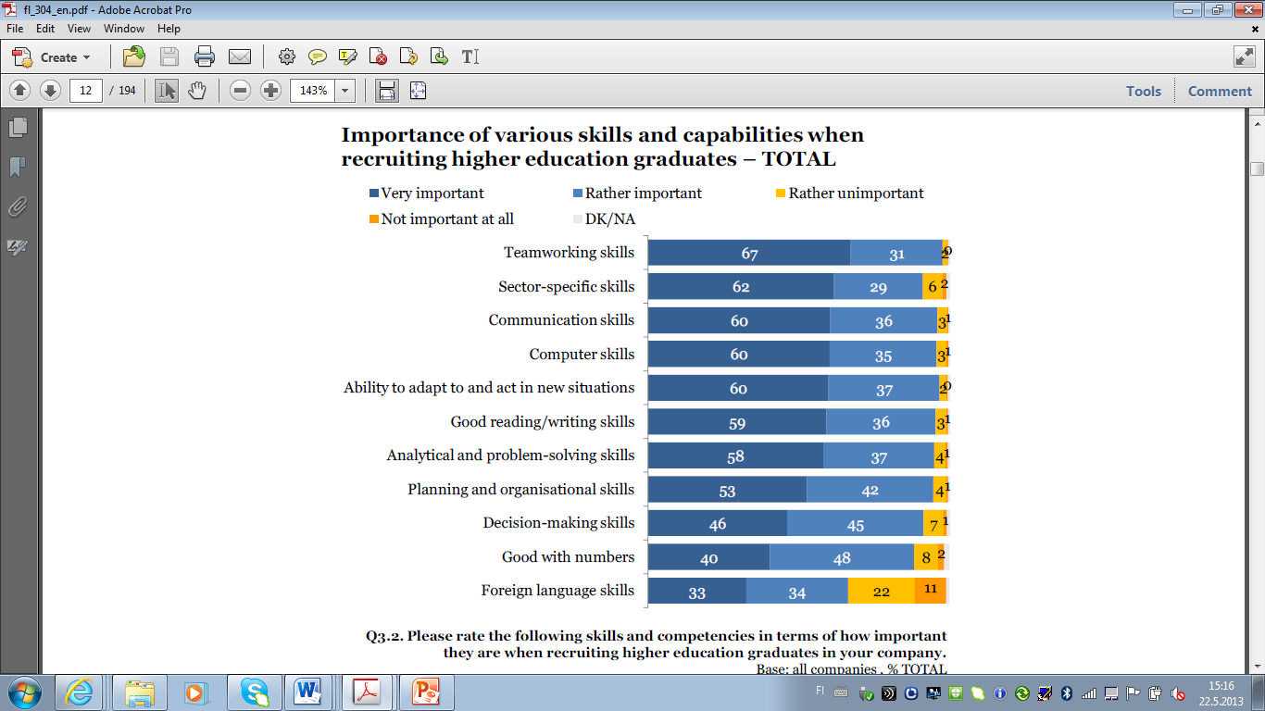
Eurostat (2010)
Flash EB No 304 – Employers’ perception of graduate employability

Slide 9
Elements of CMS
(Sultana 2011)
Personal choices and skills
  Knowing self, self-assessment, decision-making, transitions, acting in a diverse cultural environment
Links between education and work
  Courses and job opportunities, requirements, career exploration, learning skills
The labour market
  Rights and duties at work, equal opportunities, velues of different lifestyles

Slide 10
LLG in the European Guidelines on validation…
The 2009 European Guidelines on validation:
  Guidance activities in relation to the provision of guidance at different stages of the validation process
  Guidance in relation to information and guidance on the existing validation mechanisms.
Proposal for the forthchoming European Guidelines on validation:
  Information and guidance during all four stages (identification, documentation, assessment and certification) of validation of non-formal and informal learning is a necessity.
  Shared principles of validation both in I-VET and C-VET?
  The competences of assessors and guidance practitioners involved in the validation processes should be revisited in the revised European guidelines in 2014.

Slide 11
Case:
Integration of guidance within validation processes in Finland

Slide 12
Competence-based exams in Finland …2006 – 2012…
2006 | 29091
2007 | 30080
2008 | 30040
2009 | 32774
2010 | 33123
2011 | 35213
2012 | 34144

Slide 13
Competence-based qualification system in Finland
Tripartite co-operation, employers, employees and teachers
Independence of qualification from to format in which the vocational skills are acquired
Completion of the qualification/qualification module by demonstrating vocational skills at competence tests
Personalisation – supported by means of guidance

Slide 14
Personalisation
Flexible arrangements and best possible preconditions for demonstrating skills attaining competence-based qualifications and for developing and updating vocational skills required in working life
Customer oriented planning and implementation of guidance, advisory and support measures for student engaged in the validation process
=

Slide 15
Responsibility for providing information and guidance
In accordance with the contract for arranging competence-based qualifications, the organiser of the qualifications ensures that information and guidance are provided on the completion of the qualification in question, taking account of local and nationwide competence requirements in working life and the potential number of candidates completing a competence-based qualification.
Individuals interested in completing a competence-based qualification and those applying to become candidates for doing so must also be provided with expert guidance when applying for a competence-based qualification and the related preparatory training.

Slide 16
Personalisation, 3 phases
Application for a competence-based qualification and the related preparatory training
Completion of the qualification
Acquiring the required vocational skills
All of these phases must be documented

Slide 17
INTEGRATION OF GUIDANCE IN VALIDATION AND PERSONALISATION, CASE FINLAND
(Modified from the Koutsi-project 2009)
L
Labour market
Application
& Identification
Completion of qualification
Validation of
skills
Certificate
Employment
Skills
Development
Career
Management
Skills
Conclusions on:
Goals
Certificate
Recognised
Learning
Skills obtained
Need for guidance
and support
Required skills
Documentation
Tripartite evaluation
Outreached
activities &
Self-referral
Information
Motivation
Screening
& Assessment
Guidance in
relation to
screening and
recognition
(APEL)
Guidance on the validation plan
Guidance during the validation
Guidance on
future plans
Acquiring the required skills
Guidance
In transition
phase
Co-operation
Guidance on learning
Guidance on professional
development
Personalisation plan
Multiprofessional co-operation among guidance provides:
Education providers, PES, social sector, health professionals,
Voluntary sector, one-stop centers, work places, coaches, outplacement services,
Private providers etc.
Lifelong learning and lifelong guidance

Slide 18
Possible themes for guidance during the identification phase…
Examination of the initial status of candidates applying for a competence-based qualification?
Ensuring that the competence-based qualification or module in question is suitable for each applicant and that the applicant is sufficiently familiar with the contents of the qualification?
Measures in a case where the qualification in question is not suitable for a particular individual?
Identification of candidates’ previous skills?
Screening the the candidate’s need for guidance and support measures?
Taking into account of candidates’ special needs related to language and cultural background, if any?
Taking into account of any other special needs candidates may have?
Conclusions at the end of the application stage?
How to document the personalisation of the application?
…..

Slide 19
Policy implications
Design of the validation process – Development of CMS
  ”Curriculum is a tool rather than a rule”
Training of teachers/staff involved in the validation
  Competences to support individual learning paths and CMS
Training of career practitioners
  Competences both for service delivery and service design
Training of educational leaders and managers
  Leadership for networks
More differentiated delivery channels
  Integrative role of Information and Communication Technology (ICT)

Slide 20
LLG policy development and service provision are filtered through culture, economic and political conditions in each country….
LLG policy development and service provision are filtered through culture, economic and political situations in each country….
LLG policy development and service provision are filtered through culture, economic and political conditions in each country….

Slide 21
Elements of a lifelong guidance system:
LLG Policy Development
OR: LLG as an element in different policy fields
Organisations in charge of guidance service delivery
Multi-administrative co-operation
Interaction with citizens
Multi-channelled services

Slide 22
Economic & Social
development
Expected outcomes of
lifelong guidance in different levels?
Effectiveness of the educational system and the labour market
Learning outcomes
Individual Career Management Skills

Slide 23
Conclusions
Well-functioning guidance systems improve education, training & labour market efficiency & effectiveness (lower drop-out, higher productivity, addressing skills shortages and emerging competence areas)
Lifelong guidance is a pivotal element in validation
The role and locus of lifelong guidance in this respect needs to be more widely recognized!
LLG as an entitlement for citizens and an element of social contract

Slide 24
European Lifelong Guidance
Policy Network, ELGPN 2007-14
A structured tool for European co-operation
  A member state driven network established 2007
  31 members, 1 observer
  Enhancement of national solutions to meet national challenges.
  ELGPN is a conclusion to meet the challenges the policy makers and European citizens meet in implementing the EU 2020 strategies and the tools supporting the strategy (e.g. EQF,EUROPASS, ECVET, ECTS…)
  ELGPN is supported under the LLP (EU Commission 75%)
http://elgpn.eu

Slide 25

More information in the ELGPN Publications:
LLG Policy Development, European Resource Kit for Policy Makers
ELGPN Progress report 2011-12
Concept Notes
  Flexicurity,
  Youth Unemployment
  Career Management Skills
  Youth Guarantee
Glossary

Slide 26
Thank you!
For further information, please contact:
Raimo Vuorinen, Senior researcher, Ph.D.
Co-ordinator of the ELGPN
Finnish Institute for Educational Research
P.O. Box 35
FI-40014 University of Jyväskylä
tel. +358-50-3611909
Fax +358-14-617418
email: raimo.vuorinen@jyu.fi
www: http://elgpn.eu/
Skype: vuorai

